Slide 1

From The VOTE Textbook Second Edition Copyright © 2023

Slide 2


From The VOTE Textbook Second Edition Copyright © 2023
Notes:
2

Slide 3
From The VOTE Textbook Second Edition Copyright © 2023
Notes:
3

Slide 4
The VOTE Textbook Chapters
From The VOTE Textbook Second Edition Copyright © 2023
Notes:
4

Slide 5
1
2
3
4
5
6
7
8
9
10
11
12
13
14
15
16
17
18
19
20
21
From The VOTE Textbook Second Edition Copyright © 2023
Notes:
5

Slide 6
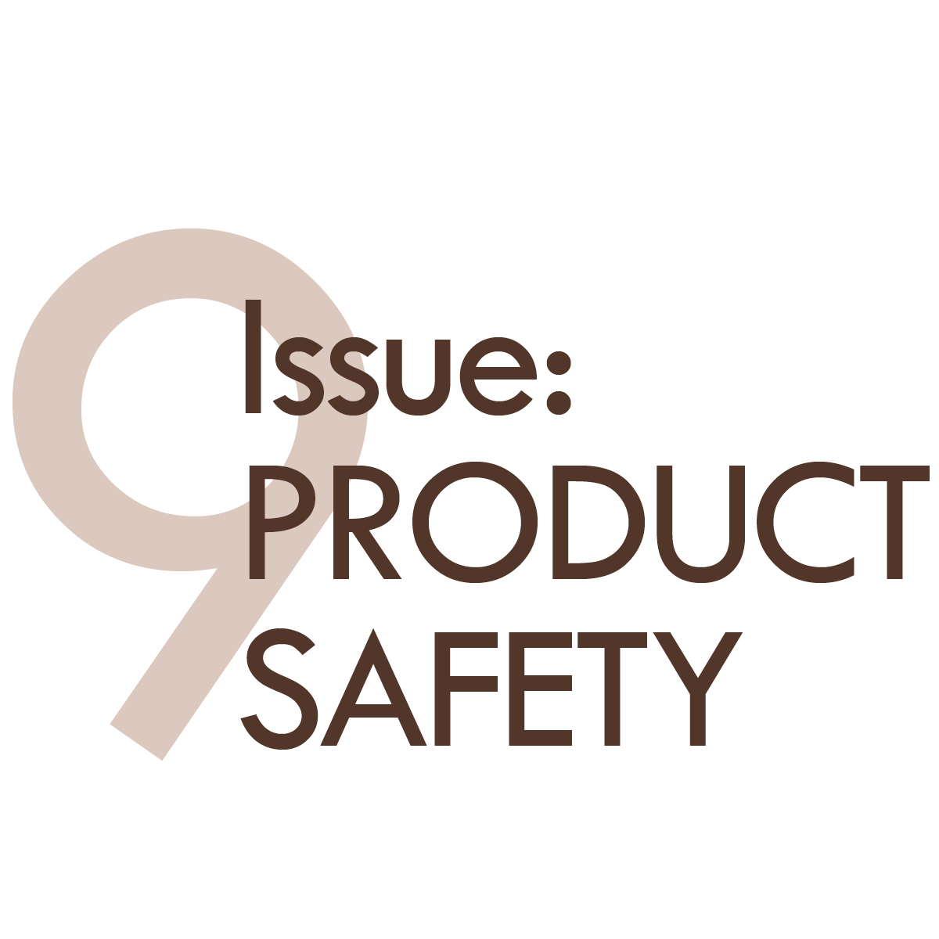
From The VOTE Textbook Second Edition Copyright © 2023

Slide 7

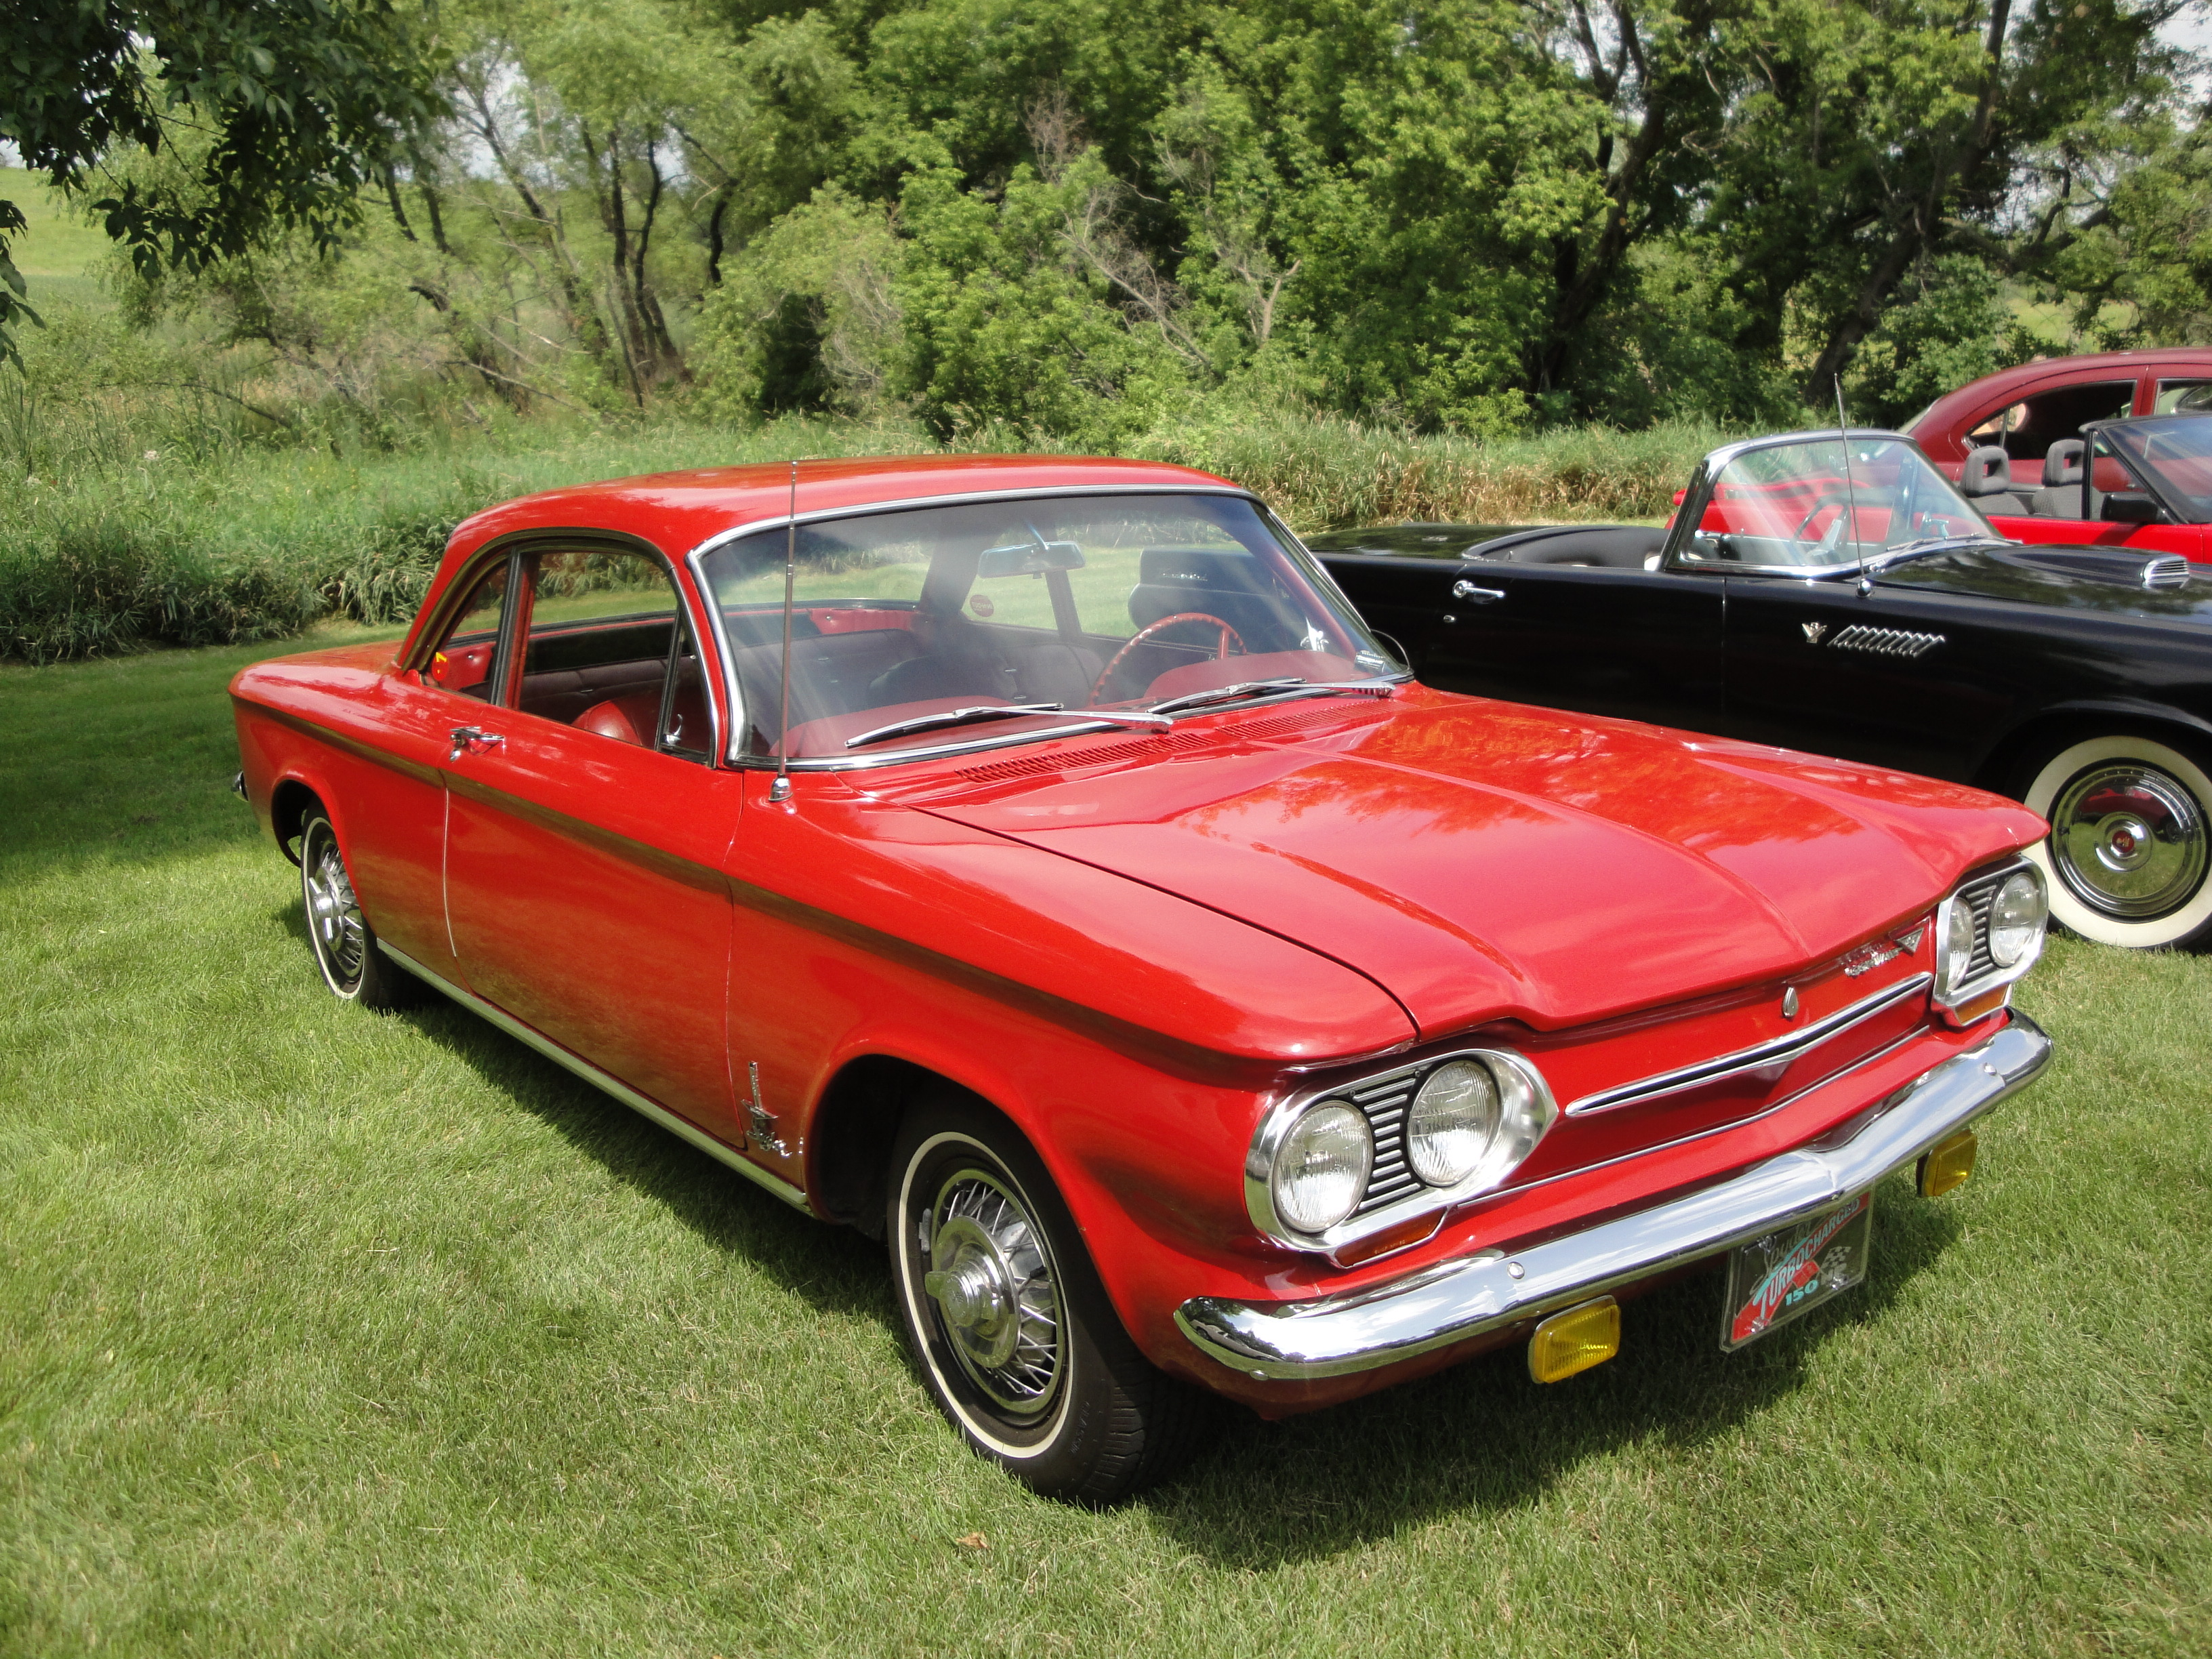
Discussion story: Chevy Corvair
Product Safety
Discussion Story
Chevy Corvair
Product
Safety
From The VOTE Textbook Second Edition Copyright © 2023

Slide 8
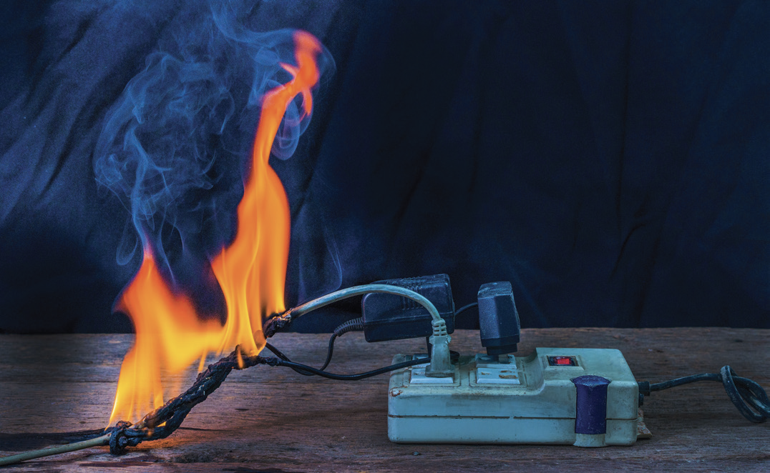
Discussion story: Chevy Corvair, cont’d
The Golden Moment
Shared Problem:
Shared Goal:
Products can cause harm
The protection that people want
From The VOTE Textbook Second Edition Copyright © 2023
Notes:
8

Slide 9

Section: Understanding the Issue of Product Safety
Product Safety
(aka Consumer Safety or Consumer Protection)
It refers to the potential of goods and services to cause harm to consumers.
From The VOTE Textbook Second Edition Copyright © 2023

Slide 10

Section: Understanding the Issue of Product Safety, cont’d
Product Safety Standards
Criteria that firms must meet before they can offer their products on the market.
From The VOTE Textbook Second Edition Copyright © 2023

Slide 11
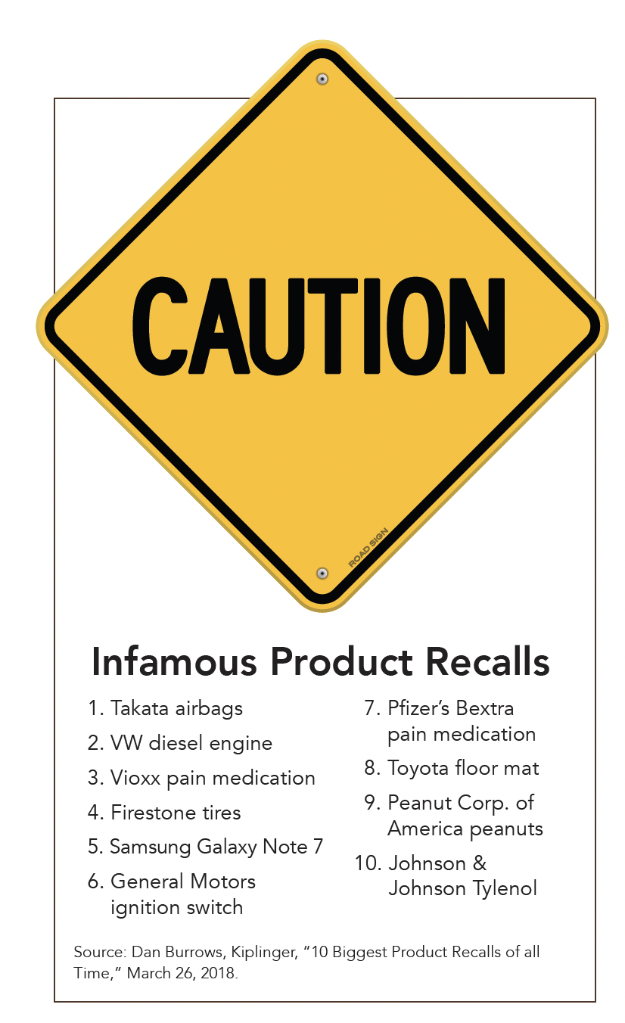
Section: Understanding the Issue of Product Safety, cont’d
From The VOTE Textbook Second Edition Copyright © 2023

Slide 12

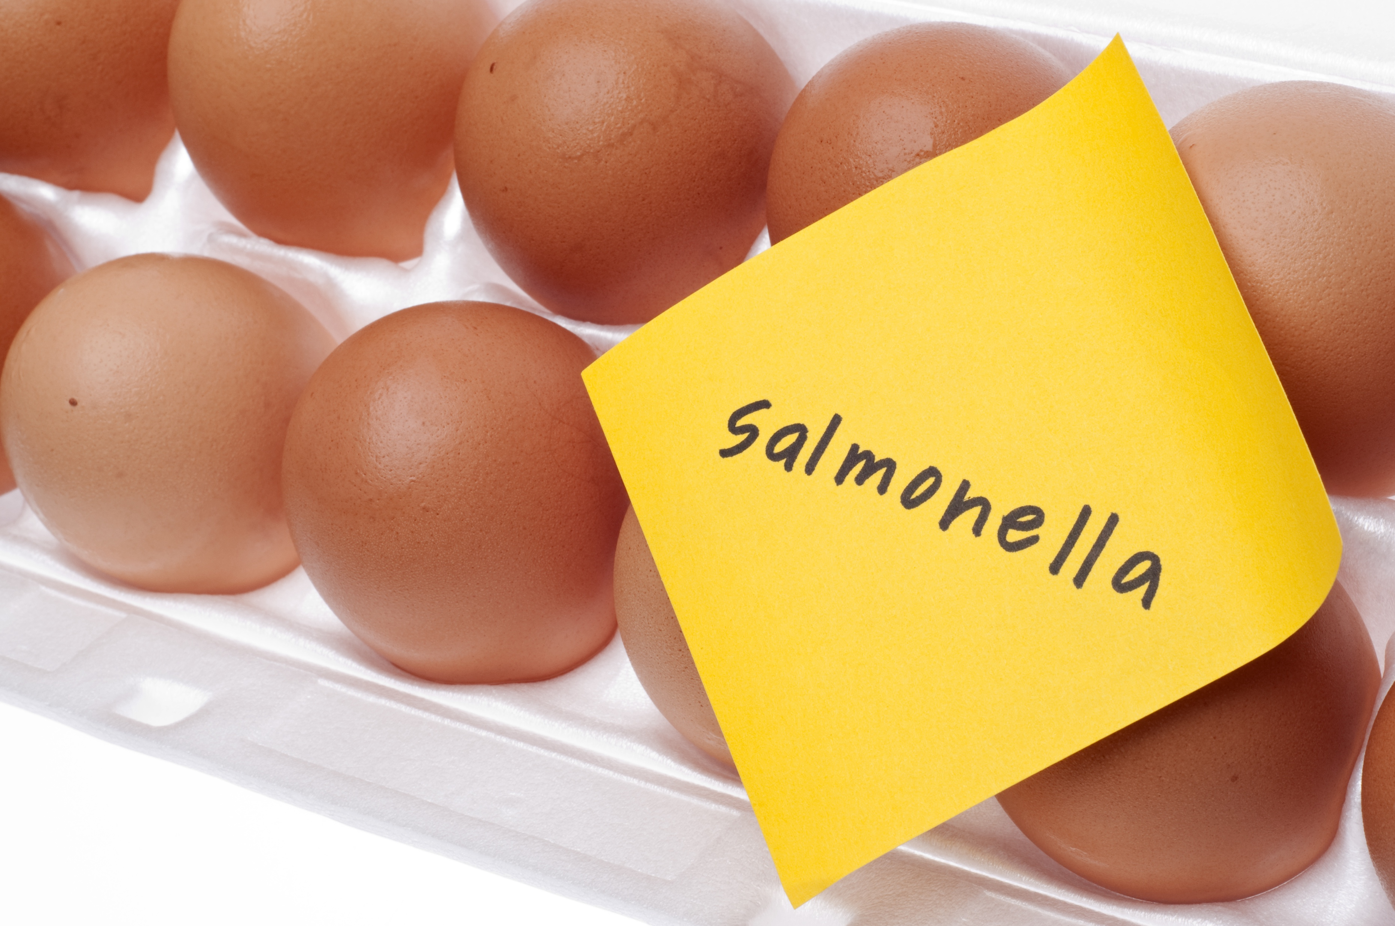
Three Ways to Ensure Product Safety
Section: Understanding the Issue of Product Safety, cont’d
  Consumers
    Consumer sovereignty, boycotts, lawsuits
  Firms
    Voluntary recalls, trade association agreements
  Government
    Regulations and agencies
From The VOTE Textbook Second Edition Copyright © 2023

Slide 13
Government Agencies Focused on Product Safety
Section: Understanding the Issue of Product Safety, cont’d
  Food and Drug Administration (FDA)
  National Highway Traffic Safety Administration (NHTSA)
  Consumer Product Safety Commission (CPSC)
  Consumer Financial Protection Bureau (CFPB)
  Federal Aviation Administration (FAA)
  Occupational Safety and Health Administration (OSHA)
  Environmental Protection Agency (EPA)
  Many others
Perhaps you can now see why some people call this an
“alphabet soup” of agencies!
From The VOTE Textbook Second Edition Copyright © 2023

Slide 14
Section: Understanding the Issue of Product Safety, cont’d
Match the Government Agency to the Product
Agency
Product
FDA
CPSC
CFPB
NHTSA
String of party lights.
Car braking system
Flu shot
Payday loans
From The VOTE Textbook Second Edition Copyright © 2023
Notes:
14

Slide 15
Polling Question
FDA
Which of the following is the FDA in charge of overseeing?
String of party lights
Car braking system
Flu shot
Payday loans
From The VOTE Textbook Second Edition Copyright © 2023

Slide 16
Section: Understanding the Issue of Product Safety, cont’d
Match the Government Agency to the Product
Agency
Product
FDA
CPSC
CFPB
NHTSA
String of party lights.
Car braking system
Flu shot
Payday loans
DAILY
DOUBLE
Vitamin supplements? FDA checks ingredients, not product claims.
From The VOTE Textbook Second Edition Copyright © 2023
Notes:
16

Slide 17

Note: We present each perspective as if we wholeheartedly agree with it. We do this on purpose to present each point of view in its best light, but please imagine each time that we are wearing a mask—as if we are actors playing three different roles.
From The VOTE Textbook Second Edition Copyright © 2023

Slide 18
L
Section: Voices on Product Safety, cont’d
iberal
Fair-Market Capitalism
Product
Safety
Stronger government oversight would have saved lives by ensuring that GM installed the anti-sway bar as standard equipment.
From The VOTE Textbook Second Edition Copyright © 2023

Slide 19
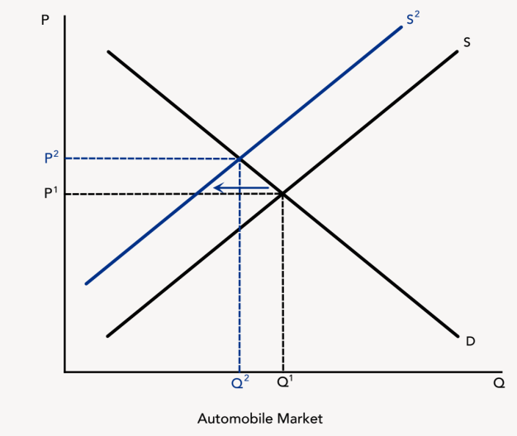
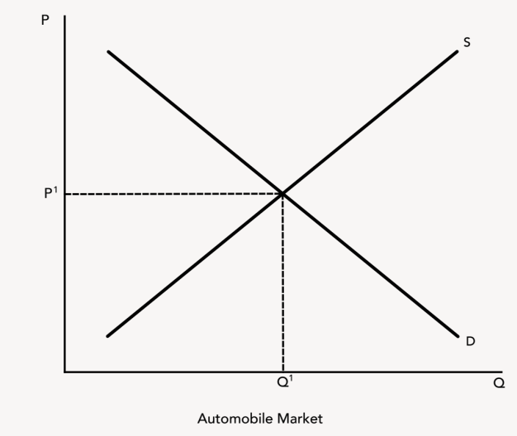
L
Section: Voices on Product Safety, cont’d
iberal
Fair-Market Capitalism
BIG PICTURE
Government guides firms and holds them accountable to produce reliably
safe goods and services, and it provides accurate information so people can
make informed choices.
POLICY POSITION
Products can cause harm to consumers, but…
Radical policies stifle creativity and ingenuity with
burdensome and inefficient bureaucracy led by amateurs.
Conservative policies irresponsibly lead to tragic and
preventable catastrophes, and steep costs for those low prices.
SOLUTION
Strengthen product safety regulations to ensure the
protection people want:
Expand government agencies to protect consumers.
Hold firms accountable to do the right thing.
Product
Safety
From The VOTE Textbook Second Edition Copyright © 2023

Slide 20
Section: Voices on Product Safety, cont’d
Product Safety Talking Points: Liberal
1. Do you trust that the toy you bought doesn’t have lead paint on it? You can trust it because we have product safety regulations and government agencies to enforce them. It’s a fact of life that sometimes products can cause harm. But we mitigate the risks through sensible safety standards. We’re fortunate to have a government with the resources and reach to do this work for us. We don’t have to wait for catastrophes to happen to get the level of protection we want.
2. Money can’t buy you happiness, and it can’t give you back your life if you’re killed in a terrible accident because of an unsafe product. That’s why I have no problem paying a little bit more in taxes and slightly higher prices to be able to have products that won’t harm or kill me or my loved ones—or anyone else. When government and business come together to create more safety in our products, the whole society benefits, and we all live happier, healthier, and longer lives.
3. Radicals, firms in democratic socialism end up making nothing but dull wooden toys because product safety councils of “stakeholders” decide what firms can produce and how they can make it. We all end up living in a nightmare scenario of over-caution. Toasters can catch fire? We’d better learn to heat our bread on sticks over the flame. The few products that do make it through the maze of the hazard assessment protocols might be safer, but we won’t have anything that we actually want.
4. The radicals have once again come up with a genius idea: use government to make products safer. Thank you for supporting consumer protection agencies, which we already have! Without boring ourselves to death in endless product safety council meetings, fair-market capitalism has efficient government agencies with the expertise and power to oversee and enforce regulations. We can have it all without overthrowing capitalism, and that means safe products in the most wealth-generating economic system ever created.
5. Conservatives say the free market naturally brings us safe products, but we hear in the news every day about products that harm and even kill people. Maybe in the long run the market would bring us safe products, but in the meantime, people are getting sick, being maimed, and dying. Some firms promise anything to get you to buy their product, but they deliberately don’t tell you about the possible negative side effects. Government makes products safer by holding firms accountable to give full disclosures to consumers.
6. You conservatives claim that consumer safety regulations do nothing more than create red tape and raise prices. Would you rather have a cheaper product that could make you sick or kill you? Or would you rather have a slightly more expensive but safer product? You are in denial about the true price of those “cheaper” products: the hospital bills, the missed work because of injuries and illness, and the funeral costs when unsafe products lead to death.
7. Our federal agencies can collect and disseminate the information about product safety that we as individuals would never be able to gather on our own. It would be impossible for an individual to amass the data necessary to do a comparative analysis for every product used in daily life. Government works for us and gets it done, and we each pay a few tax dollars to get this lifesaving service. It’s a great deal. We should be grateful to live in a country where we have consumer protection agencies.
8. In capitalism, firms are motivated to make us what we want, but sometimes their products have design flaws, or the inputs they use are tainted, or the assembly is faulty. Firms get sued, and they lose money and their good reputations. Consumer protection agencies help them by creating safety standards. Because all firms must follow the same regulations, no one suffers from unfair competition. Businesses thrive and consumers stay safe thanks to the public-private partnership.
From The VOTE Textbook Second Edition Copyright © 2023

Slide 21
R
Section: Voices on Product Safety, cont’d
adical
Democratic Socialism
Product
Safety
GM was pressured to cheap out and make an extra penny of profit by not installing the anti-sway bar. People died because of capitalism.
From The VOTE Textbook Second Edition Copyright © 2023

Slide 22

R
Section: Voices on Product Safety, cont’d
adical
Democratic Socialism
Product
Safety
BIG PICTURE
We have safe and innovative products because we harness the expertise of
many stakeholders to make sure firms are both supported and held accountable.
POLICY POSITION
Products can cause harm to consumers, but…
Conservative policies harm consumers because in free-market
capitalism unsafe products are inevitable and even acceptable
when cost-effective.
Liberal policies lull us into a false sense of security because
capitalism always leads firms to value profit over the safety of people.
SOLUTION
Replace product safety regulations in capitalism with product
safety council policies in democratic socialism to ensure the
protection that people want:
Establish hazard assessment protocols.
Firms have buy-in to produce safe products.
From The VOTE Textbook Second Edition Copyright © 2023

Slide 23
Section: Voices on Product Safety, cont’d
Product Safety Talking Points: Radical
1. I want to live in a society where I can trust that the products I use won’t harm me. Is that too much to ask? Apparently, it is—in capitalism! There’s only one way to really be sure firms are committed to making us the safest possible products, and that’s through democratic socialism. Firms are pressured to do the right thing because while profit is important to any business, it’s never more important than people’s well-being.
2. I’m tired of worrying that my phone is giving me a brain tumor or that the airbag in my car might kill my passenger. We all want to sleep peacefully at night knowing the products in our lives aren’t making us sick or harming our loved ones. And we all want to sleep peacefully at night knowing that the products we make aren’t causing harm. We can have this when our economic system values the well-being of all.
3. The conservative idea to leave it alone really leaves the fox in charge of the hen house. It won’t make us safer; it will do the opposite—because in free-market capitalism, profit is the incentive for firms to act. They cheap out and cut corners on safety in order to boost their bottom lines and beat out the competition. Again and again, we hear about firms who did the math and concluded that harming their customers was more profitable than making their products safe—even factoring in the high cost of lawsuits.
4. Conservatives, you say the free market gives us what we want, but the last time I checked, no one wants toxic chemicals in their food, airbags that kill front-seat passengers, or toys coated in lead paint. Your simple-minded idea that the market naturally self-adjusts to give us the safety we want is incredibly dangerous. How many will first have to die? When it’s in our power to prevent tragedies, we absolutely should.
5. No amount of liberal regulations or oversight will ever fix the problem of unsafe products because fair-market capitalism has a fatal flaw: top-down governance. Politicians aren’t held accountable to their constituents, and they are routinely corrupted by campaign contributions. Firms hire lobbyists to make sure that laws are written in their favor so they can make more profit at the expense of our safety. In the end, it’s the people who suffer with injuries and deaths that could have—and should have—been avoided.
6. Liberals, face facts: your alphabet soup of consumer protection agencies hasn’t solved the problem of unsafe products, and it never will. Government acts like the school disciplinarian, giving corporations detention and a slap on the wrist, but those firms are willing to risk being fined and continue to make unsafe products when it brings them more profit. That’s business as usual in capitalism. The liberal idea of government regulation doesn’t ensure our safety because it’s a top-down solution in a profit-driven system.
7. Product safety councils bring together the people who have the most knowledge and experience about the product and about safety, including experts from industry, firms, consumer groups, and government. Because diverse stakeholders work together, we get the highest level of safety. Government officials convene and facilitate product safety councils and advocate for their policies in Congress, the state legislature, and so on. Good ideas percolate up and become our nation’s policies, so we all have buy-in.
8. In democratic socialism we can trust that the products we use were made with our best interests in mind. Product safety councils’ hazard assessment protocols guide firms to create safer products. When a new product is designed and manufactured, teams of experts assist firms to make sure there are no dangerous flaws that could cause harm. This is good for firms and for society because we get the safety we want, and firms get the support they need when they launch new and redesigned products.
From The VOTE Textbook Second Edition Copyright © 2023

Slide 24
C
Section: Voices on Product Safety, cont’d
onservative
Free-Market Capitalism
Product
Safety
GM respected customers by giving them the choice. They could read the reviews and decide for themselves whether to buy the anti-sway bar.
From The VOTE Textbook Second Edition Copyright © 2023

Slide 25
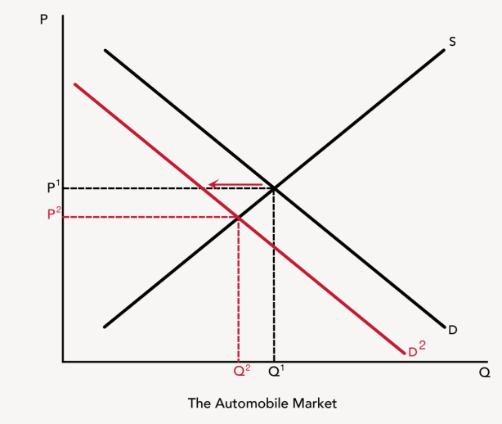
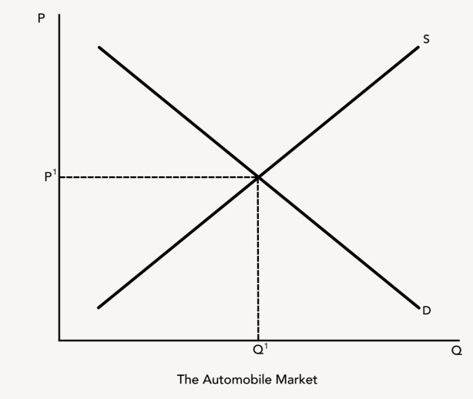
C
Section: Voices on Product Safety, cont’d
onservative
Free-Market Capitalism
Product
Safety
BIG PICTURE
Markets self-regulate to bring us the level of safety we want in products when
we are free to choose for ourselves.
POLICY POSITION
Products can cause harm to consumers, but . . .
Liberal policies result in a false sense of security, fewer
choices, squelched innovation, higher taxes, and higher prices.
Radical policies are bad for business because they discourage
entrepreneurs and kill the drive for progress with endless
meetings and competing agendas.
SOLUTION
Reject product safety regulations and replace them with
unfettered price signals to ensure the protection people want:
Markets for information emerge.
Consumer demand determines the safety of goods and services.
From The VOTE Textbook Second Edition Copyright © 2023

Slide 26
Section: Voices on Product Safety, cont’d
Product Safety Talking Points: Conservative
1. The beauty of free-market capitalism is that all we have to do is leave markets alone and unsafe products will no longer be produced. The problem fixes itself because consumers vote with their dollars. They won’t buy the product, and then firms will either change the product to make it safe or they’ll make something else or the firm will go belly up. In any case, the unsafe product will no longer be a problem.
2. The free market works because everyone is self-interested and therefore takes responsibility for their own decisions. We get the safety we want in products by doing the research. Before we purchase something new, we naturally look up the reviews. There are countless websites dedicated to giving us information that helps us make the best decisions for ourselves. We don’t need government to tell us what we can and cannot buy. We never have to trade our liberty for safety.
3. You liberals think that the FDA and OSHA and all those other government agencies are keeping us safe, but they’re doing the opposite by giving consumers a false sense of security. You require people to wear seat belts, and then people drive faster because they feel invulnerable, which leads to more accidents. And all the red tape generated by those agencies keeps useful products from reaching the market because it takes so long to navigate the maze of safety regulations.
4. I don’t need government agencies to tell me I shouldn’t let my baby play with something sharp. When we rely on the liberal nanny to tell us it’s safe to cross the street, we don’t take responsibility to learn to look both ways to make sure we won’t get hit by a bus. On top of that, all those government agencies limit innovation and choice—and cost us a bundle along the way when our taxes go up and prices for products skyrocket.
5. Invention requires hard work and risk taking. In democratic socialism, you radicals create obstacles to both. First, there is no incentive to work hard because there is no profit motive. Second, those few who are still willing to be entrepreneurs run into the brick wall of product safety councils. When a new folding chair is invented, a stakeholder worries about the possibility of fingers getting pinched. The council then creates a slew of new hazard assessment protocols, and entrepreneurs just give up and go home.
6. The radical idea to solicit everyone’s input about the safety of products is actually the fundamental premise of free-market capitalism. Price signals let each and every consumer express their needs and concerns about the level of safety they want by voting with their wallets. Unlike in democratic socialism, we achieve this outcome without time-wasting, soul-crushing committee meetings where nothing is ever decided and nothing ever gets made.
7. In free-market capitalism, consumer demand drives markets. People do their own research and decide what products to buy. If they need or want more information, then a market for independent, unbiased product safety information will emerge. From the point of view of suppliers, it is beneficial to make safety information available because it improves their competitiveness. Firms voluntarily invest in the testing to ensure safer products because firms follow the profit motive, and safe products are good for business.
8. When we leave the market alone, we get the level of product safety we want because people don’t buy products that hurt them. It’s that simple. So we don’t need any council or regulations to represent the needs and desires of consumers. Those are already communicated through the choices made every day when we decide what to buy and what not to buy. By ridding society of stifling government interference, everyone benefits. We get innovative products cheaper, faster—and safer, if that’s what we want.
From The VOTE Textbook Second Edition Copyright © 2023

Slide 27
Section: The Shared Outcome
Now you’ve heard the arguments from all three perspectives.
They all share the goal of having
the protection that people want.
It’s time for you to
join the
conversation!
From The VOTE Textbook Second Edition Copyright © 2023

Slide 28

Section: Activity: Role-Play
Product Safety Activity: Role-Play
“Breakfast with the Family”
From The VOTE Textbook Second Edition Copyright © 2023

Slide 29
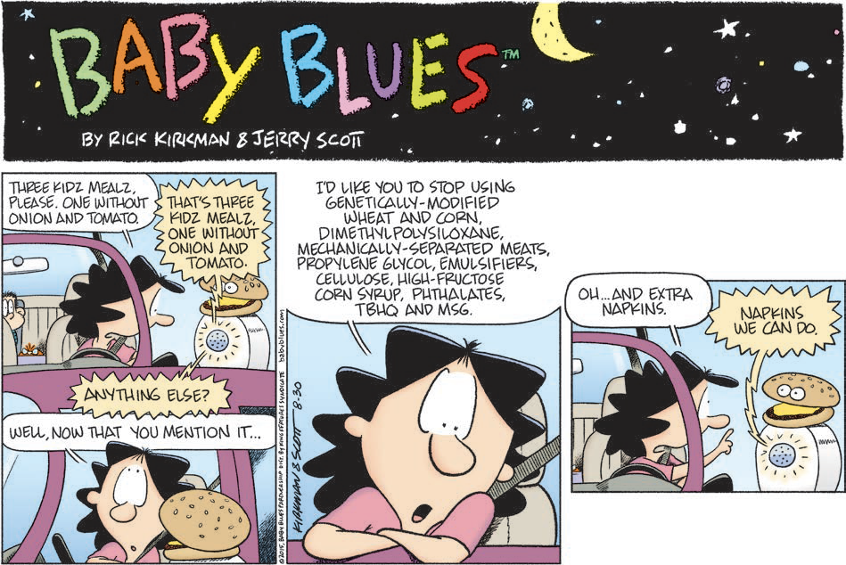
Section: Activity: Role-Play, cont’d
This is the comic used for the activity:
From The VOTE Textbook Second Edition Copyright © 2023

Slide 30
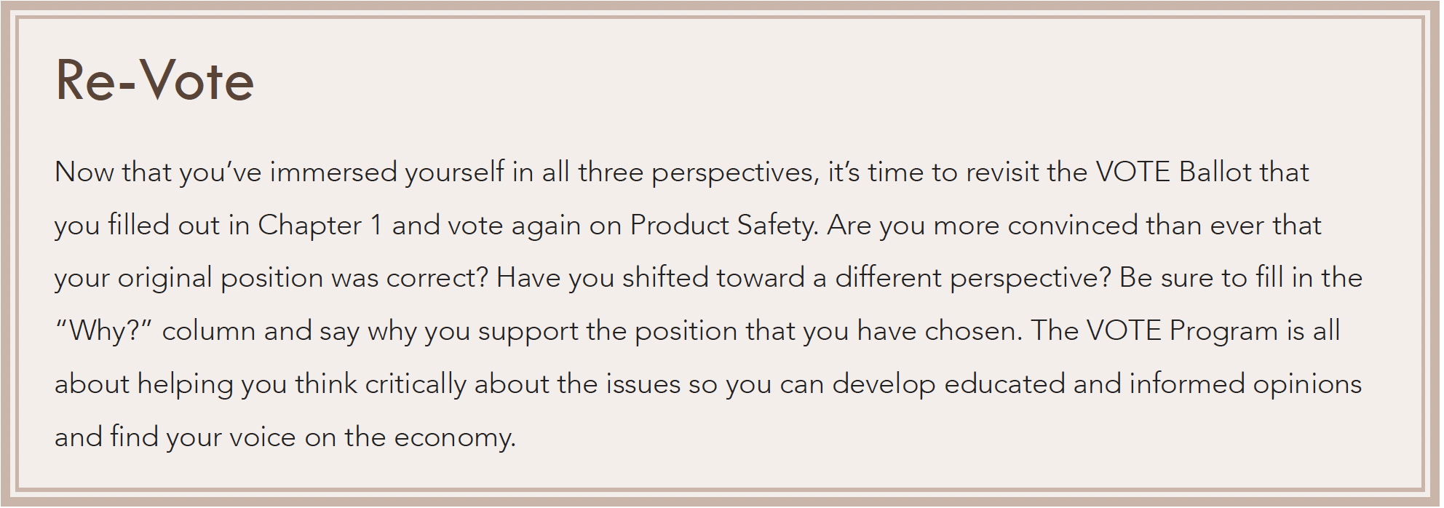
Section: Activity: Role-Play
Product Safety Activity: Re-Vote
From The VOTE Textbook Second Edition Copyright © 2023

Slide 31

Chapter 9
Check out the book for more!
Test Yourself • Key Terms • Answer Key
From The VOTE Textbook Second Edition Copyright © 2023

